Slide 1
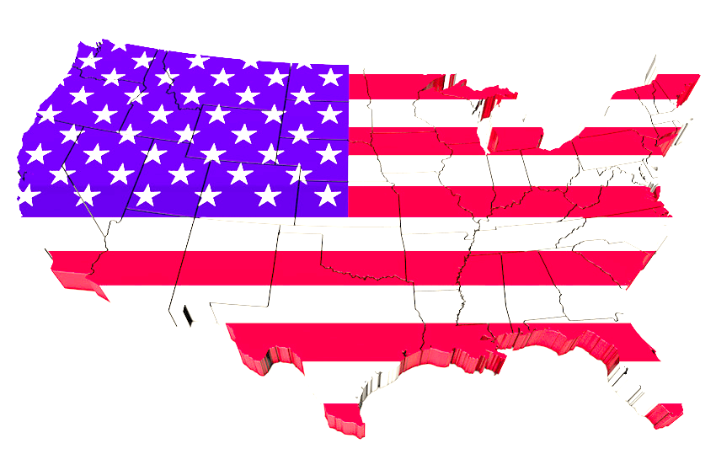
Federalism

Slide 2
What is federalism?
Federalism is the division of powers between the federal, or national, government and state governments.

Slide 3
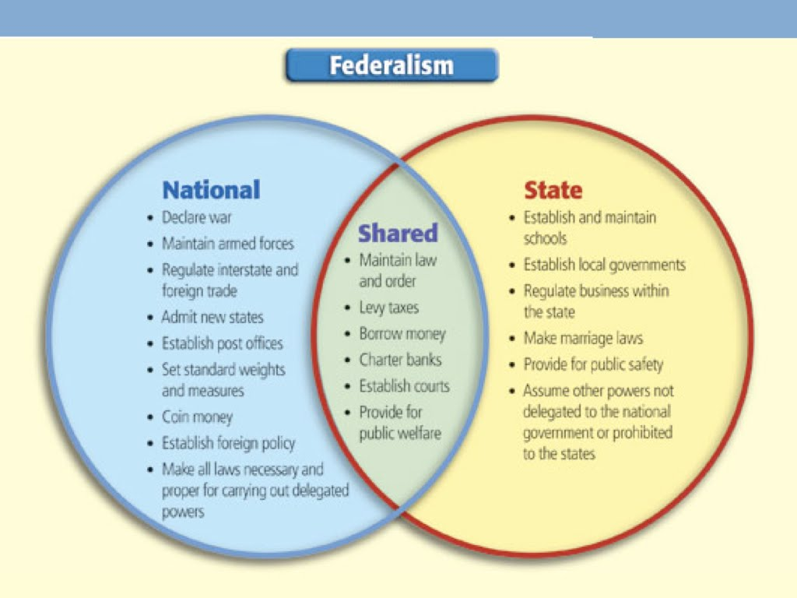

Slide 4
What does the Constitution say?
To protect state rights, the 10th Amendment says any power not specifically given to the federal government is given to the states.
To protect federal power, the Constitution contains the Supremacy clause, which states that it and other federal laws supersede state laws.

Slide 5
Where does this become a problem?
Gay Marriage
CA voters approve Prop. 8, defining marriage between a man and a woman
The federal court says this violates the 14th Amendment, which gives equal protection to all U.S. citizens
Gun Ownership
The cities of San Francisco and Chicago, as well as the District of Columbia, passed laws banning handguns
The federal courts overturned these laws, citing the 2nd Amendment’s protection of the right to bear arms
Marijuana
CA voters approve prop 215, which allows for medicinal marijuana
The federal government classifies marijuana as a drug, and reserves the right to raid “pot shops”

