Slide 1
You Be The Judge

Slide 2
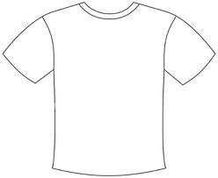
“Abortion is Homicide. You will not mock my God. You will stop killing my generation.”

Slide 3
Allowed (not disruptive)

Slide 4
Silhouettes of men holding rifles, the letters “NRA,” and the phrase “shooting sports camp”

Slide 5
Allowed (not disruptive)

Slide 6
Jeff Foxworthy “you might be a redneck” jokes

Slide 7
Allowed (not disruptive)

Slide 8
“Coed Naked Band: Do it to the Rhythm”

Slide 9
No (vulgar)

Slide 10
“Somebody went to Hoover Dam and all I got was this DAM shirt”

Slide 11
No (vulgar)

Slide 12
Image of George W. Bush over the caption “International Terrorist”

Slide 13
Allowed (not disruptive)

Slide 14
Anti- Nazi Patch (red circle with a line through it over a swastika)

Slide 15
Not allowed (potentially disruptive)

Slide 16
“Bong Hits for Jesus”

Slide 17
Allowed (not disruptive or lewd)

